Slide 1
AI-ENABLED STUDENT MANAGEMENT SYSTEM

Slide 2
TABLE OF CONTENTS
01
06
Future prospects
What we are working on?
02
05
Our Goals
About the Project
Problems we are facing now.
03
06
Sneak Peek

Slide 3
WHAT WE ARE WORKING ON
SECURE
ACCESSIBLE
FAST AND RELIABLE
Focusing on building a user-friendly secured website so that the information is safe on the site.
Building a website that is easily accessible.
A website that gives information without any delay.

Slide 4

ABOUT THE PROJECT
Artificial Intelligence based student management system focuses on building a student management system having the following features:
An interactive website for students,faculty and other users.
Portfolio for students .
About the Institute .
Contact information.

Slide 5
-Dave Waters
“PREDICTING THE FUTURE ISN’T MAGIC ,IT’S ARTIFICIAL INTELLIGENCE”

Slide 6
NOW
INATTRACTIVE INTERFACE
PROGRAMMING MISTAKES
LACK OF ADAPTABILITY

Slide 7
FUTURE
USER FRIENDLY INTERFACE
ADAPTABILITY
ADDED FEATUERS

Slide 8
OUR GOALS
POSITIONING
EXPANSION
USABILITY
It has various added features so that it is easy for user to access the site in just one click.
It help us to reach more and more people and make it easy access to everyone.
A User friendly website that is handy to use

Slide 9
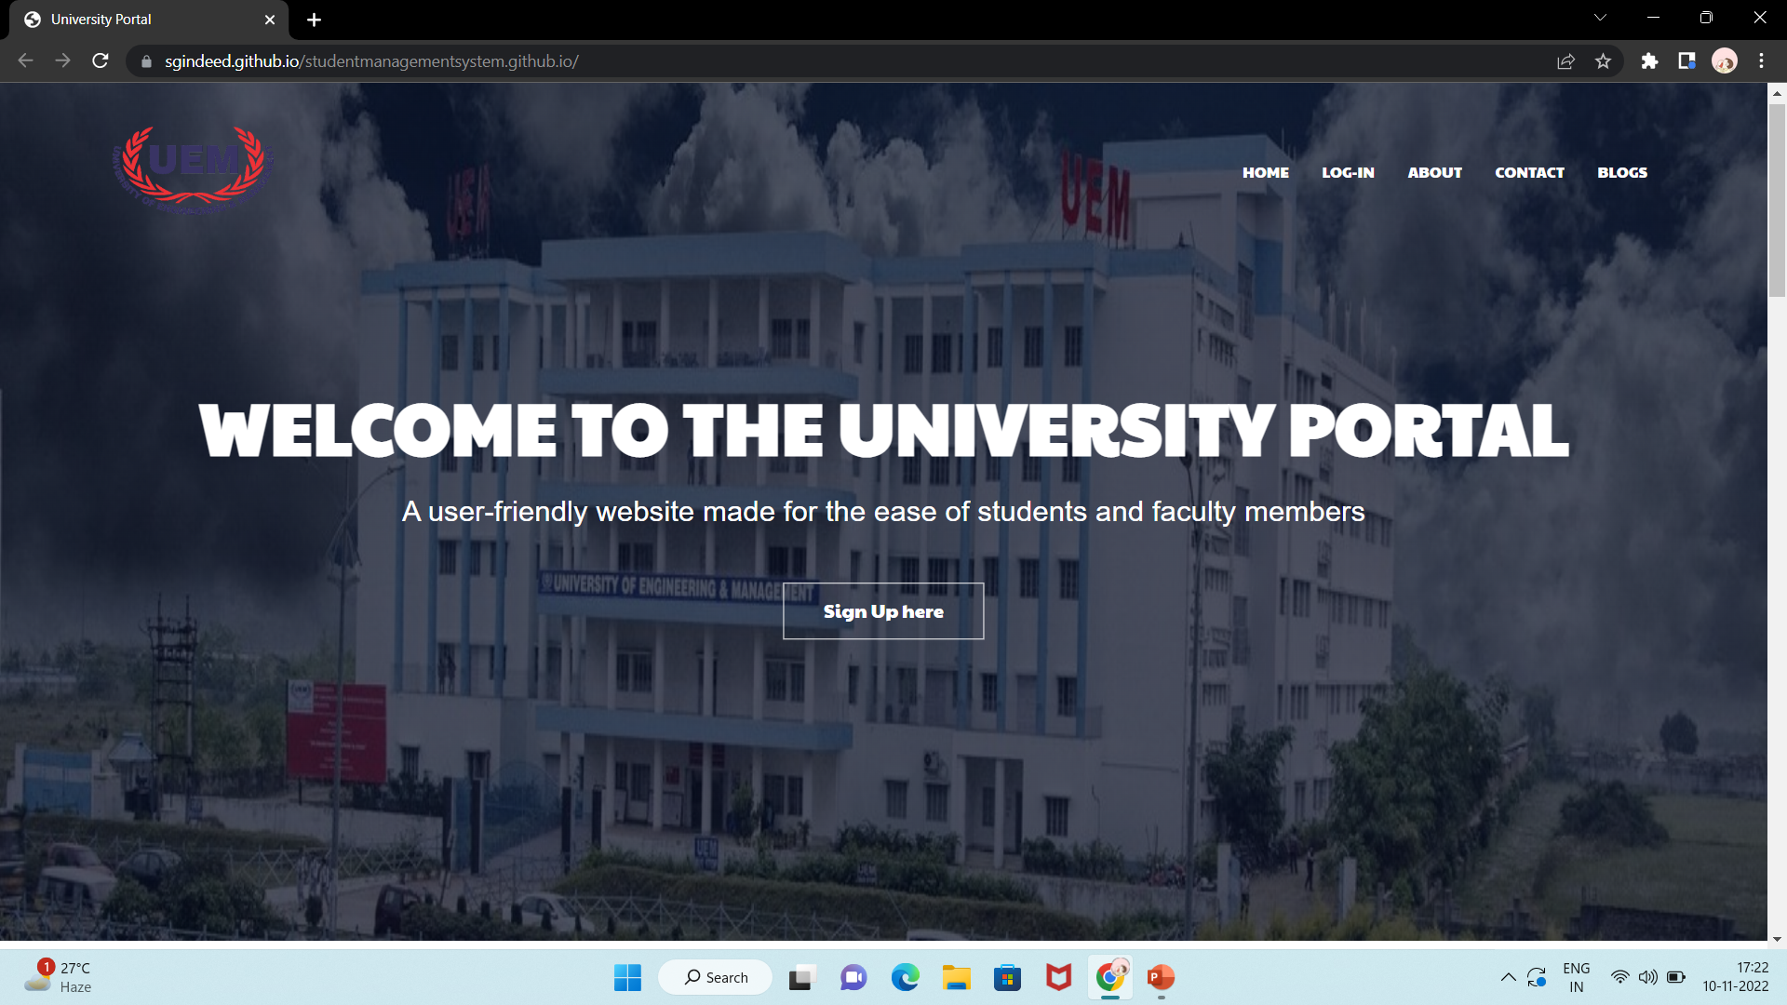
Our website link:
https://sgindeed.github.io/studentmanagementsystem.github.io/#

Slide 10
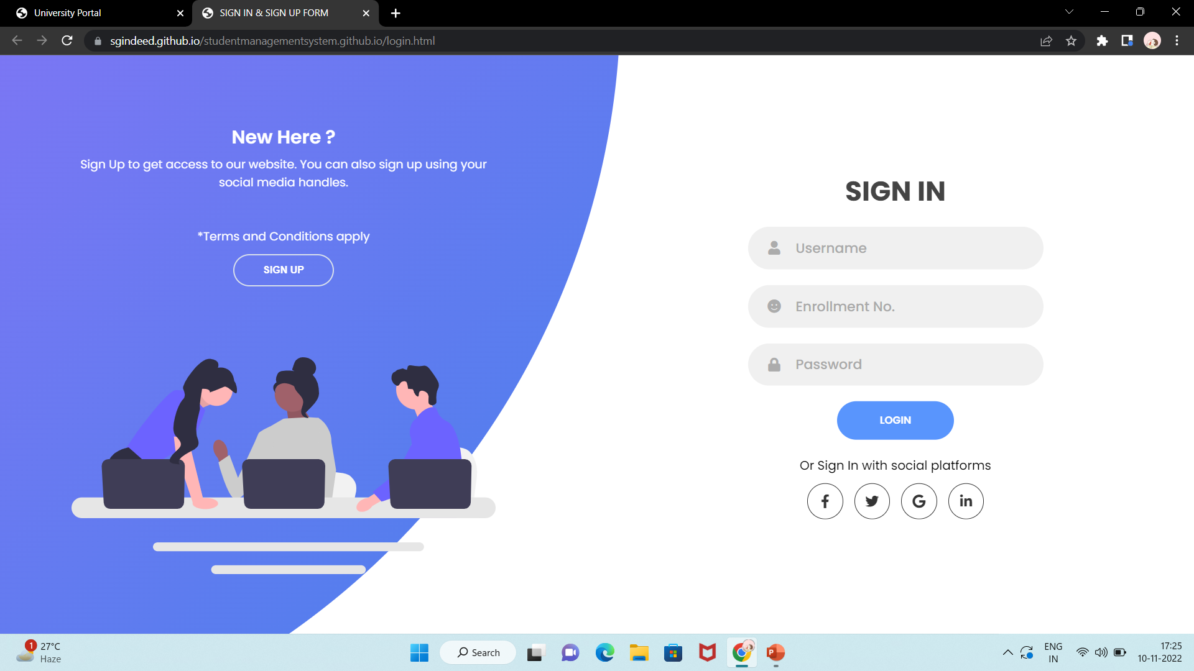
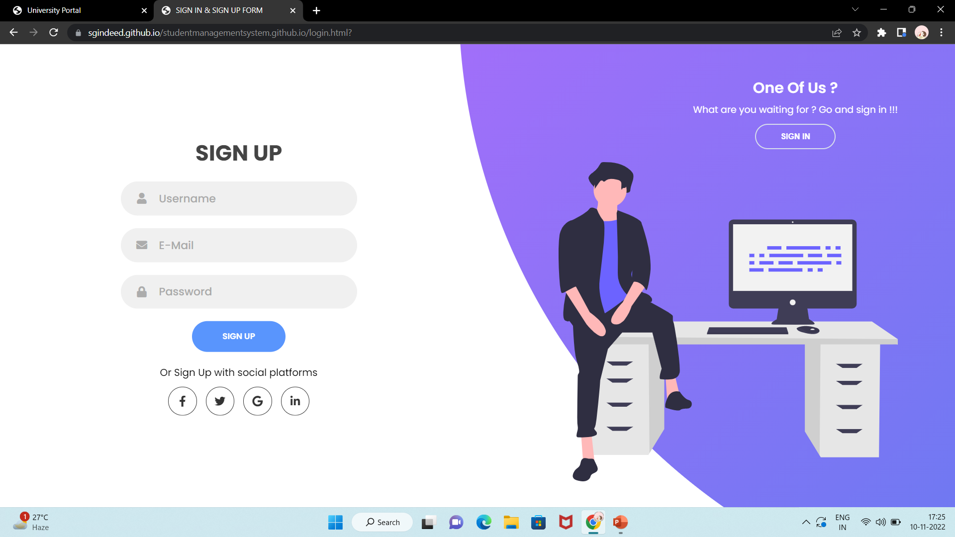
SNEAK PEEK

Slide 11
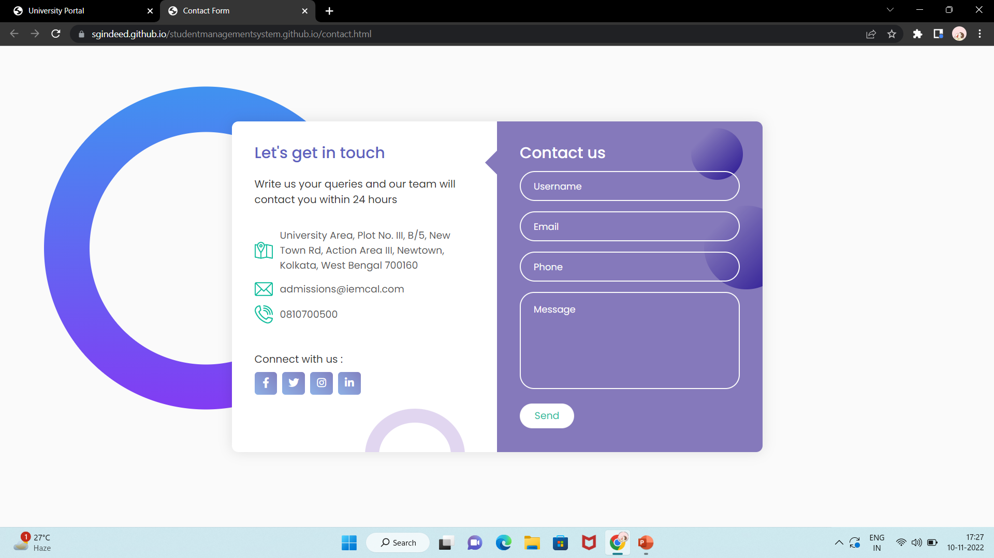
SNEAK PEEK

Slide 12
THANK YOU!!
Does anyone have any question?

